Slide 2
Partnering
AGENDA
Partnering Process
Specifications
108.02: Self-Facilitated Partnering
Proposal Note 111: Facilitated Partnering
Facilitated Partnering vs DRB / DRA

Slide 3
Partnering

Slide 4
Partnering
Misconceptions about Partnering…
“Horse-trading”
Trust Falls & Hand Holding
Sacrifice
Expecting extra work for free
Relaxing specifications
A replacement to the Contract

Slide 5
Partnering
“Partnering is the formal process of creating a cooperative team by resolving issues in a timely manner. The Partnering Process facilitates an environment that enables all stakeholders to develop a relationship based on communication, trust, and respect.”
- ODOT Partnering Homepage

Slide 6
Partnering
Partnering is the Process of Preventing Disputes
Collaborative Process
CMS 108.02 – Self Facilitated Partnering
Part A: Preconstruction Meeting
Part B: Initial Partnering Session
Part C: Progress Meeting
Part D: Post-Milestone Meetings
Part E: Partnering Monitoring
Part F: Mitigation & Notice
Notes:
Standard for all Projects
Does not affect terms and conditions of Contract
All costs are incidental to contract
ODOT Project Engineer and Contractor will be the Facilitators

Slide 7
Partnering
Statewide Partnering Goals
Safety
On Time & On Budget
Timely Issue Resolution
Respect the Environment
Partner with Stakeholders
Trust & Respect
Mitigation
Transparency
Quality
Open Effective Communication
Project First Focus
Notes:
Standard for all Projects
Does not affect terms and conditions of Contract
All costs are incidental to contract
ODOT Project Engineer and Contractor will be the Facilitators

Slide 8
Partnering
PN 111 – Facilitated Partnering
Neutral Facilitator
Who, What, When, Where, & How…
List of 41 Approved Facilitators
ODOT Facilitators Standard & Expectation Manual
Mutually agreed upon by ODOT & Contractor
Max: $3500 for Initial, $1500 for Re-connects
Approximately 25 Projects since 2012

Slide 9
Partnering
PN 111 – Facilitated Partnering
Project Type?
Project Value
Funding Sources
Project Duration
Project Complexity
Utility & Railroad Involvement
Project Location & Visibility
Public/Stakeholders and their Goals
Notes:
Details for consideration:
Project value (greater than $5 million);
Multiple funding sources for the project;
Project duration (multiple year);
Project complexity (complex maintenance of traffic/ phasing/ environmental/technical issues);
Extent of utility & railroad involvement (significant relocations/crossings);
Project location and its visibility (urban high profile);
Number and diversity of the stakeholders and their goals (multiple diverse goals);
Stakeholders’ experience with Partnering (some stakeholders have no experience);
Coordination issues (major milestone dates/adjacent projects); and
Public involvement (multiple interest groups)

Slide 10
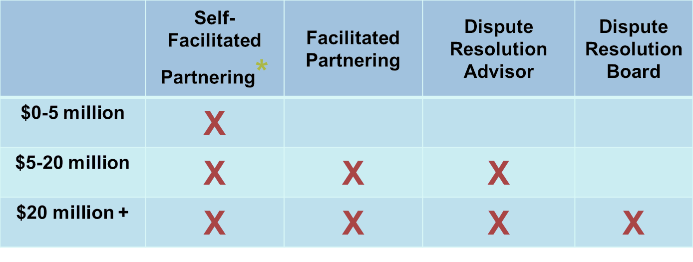
Partnering
Project value guidelines
Minimum requirements for all projects

Slide 11
Partnering
Partnering vs. DRA/DRB
DRB/DRA process is distinct from, but complementary to, the partnering process (PN 108 and 109).
DRB/DRA process focuses primarily on dispute resolution, with some dispute prevention aspects.
Partnering focuses more on day-to-day project management issues, problems, and communications.

Slide 12
Partnering

Slide 13
Disputes and Claims
2015

Slide 14
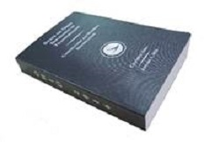
Claims Process
C&MS 108.02(G)

Slide 15
Claims Process
1 – Project level
2 – District Level (DDRC)
3 – Central Office (DCB)

Slide 17
C&MS Changes for 2016
Engineer to Provide Step 2 Docs
Step 3 Documents - Time Extensions
Increasing the DCB’s Control of the Hearing
Step 3 Presentation By Employee
ADR By Agreement

Slide 18
Step Two Meetings (DDRC) - 2015
Step Two (DDRC)
Dispute | County/Route/Section | Contractor | Step 2 Meeting Date | Dispute
01-148010-03 | HAN-75-3.22 | Becdir Construction Co. | 1/18/15 | MOT/Project Suspension
02-130027-01/8 | OTT-2-25.05 | The Beaver Construction Co. | 11/3/15 | #8 Barrier Grout Mix Design
02-130395-03 | LUC-65-5.35 | Atsalis Bros. Painting | 1/6/15 | Winter Bridge Painting
02-140032-01 | WOO-475-0214 | Gerken Paving, Inc. | 4/14/15 | Temporary overhang falsework
02-140170-01 | WOO-75-10.61 | Kokosing Construction Co. |  | Blended Unit Prices
02-140268-01 | WOO-75-2.75 | Kokosing Construction Co. |  | Tack Coat Base Course
02-143000-01 | HAN/WOO-75-18.92/0.00 | Miller Brothers Const. | 9/4/15 | 48” Conduit
03-130001-01 | LOR-58-7.36 | The Beaver Construction Co. | 8/17/15 | Distorted Deck Plates
04-143005-01 | SUM-271-12.47/SUM-82-3.93 | Great Lakes Construction Co. | withdrawn | Payment for SWPPP
04-143005-02 | SUM-271-12.47/SUM-82-3.93 | Great Lakes Construction Co. | Settled | Railroad Steel Erection Redesign/Delay - Settled for $136,907
04-138033-01 | SUM-271-2.33 | Anthony Allega | 11/30/15 | Girder Line
06-120541-02 | PIC-762-11.18 | Fechko Excavating | 2/24/15 | Delay Claim/Liquidated Damages
06-130402-01 | FRA-23-22.23 | Ruhlin/Igel JV | 1/30/15 | Over Break on Shale Excavation
06-133006-02 | FRA-270-52.72 | Complete General | 4/27/15 | Asphalt Pavement mill steps
08-120599-01 | HAM-75-2.30 | Kokosing Construction Co. | 3/3/15 | Delay/Constructability
09-143018-01 | HIG-County Bridge 9 | E.L. Robinson |  | Bridge Footing Design
09-110628-01 | LAW- Ironton Russell Bridge | Brayman Const. | 1/21/15 | Anchor Box Distortion
09-140078-01 | LAW- -75.46 | Complete General Construction Co. | 1/12/16
10-130508-01 | WAS-Training Annex Bldg. | 21st Century Concrete Construction, Inc. | 7/28/15 | Liquidated Damg/Extra Work
10-140113-01 | HOC-664-16.18/16.30 | Cross Roads Construction | 3/3/15 | Changed subsurface cond.
12-130151-01 | CUY-87-4.24, Parts 1-2 | Great Lakes Construction | 6/29/15 | NonPerf Cofferdam/Bracing
12-145003-01 | CUY-237-8.24 | Perk Company | 2/9/15 | Water & Monument Box $ Adj.
12-15000-01 | CUY- Chagrin Falls | Anthony Allega Cement Contractors | 6/11/15 | Underdrain Fill
12-140473-01 | CUY-Canal Rd | Great Lakes Construction Co. |  | Micropile differing site cond.
12-110499-01 | CUY-90 | Anthony Allega Cement Contractors | 10/29/15 | Repair to Parapet Epoxy sealer
12-140540-01 | CUY-IR71-12.45 | Cosmos Industrial Services, Inc. |  | Interpret 511.14 curing/loading

Slide 19
Step Three Hearings (DCB)
12 New Claims Filed (5 from 2014)
8 DCB Hearings
3 Mediations
4 Dropped/Settled
2 Pending
2 Filed in 2016

Slide 20
Step Three Hearings (DCB)
Claim | Contractor | Resolution Type | Demand
06-133006-01 | Complete General | Claim's Board | $ 24,102.93
04-130613-01 | A.P. O’Horo | Withdrawn | $ 36,386.31
06-130402-01 | Ruhlin/Igel JV | Settled by District | $ 1,044,128.00
01-148010-03 | BECDIR Const. | Withdrawn | $ -
04-101078-01 | Anthony Allega | Claim's Board | $ 692,287.40
10-140113-01 | Cross Roads Construction | Mediation | $ 151,985.00
08-133025-01 | Great Lakes | Claim's Board | $ 30,444.75
06-133006-02 | Complete General | Settled by District | $ 74,218.00
12-140062-02 | 360 Construction | Claim's Board | $ 265,857.00
08-130086-01 | Sunesis Construction | Mediation | $ 378,475.63
02-130395-01 | Atsalis Bros. | Claim's Board | $ 2,085,133.00
02-130395-02
06-120541-02 | Fechko Excavating, Inc. | Claim's Board | $ 213,002.46
02-130027-02 | The Beaver Excavating Co. | Mediation | $ 2,447,426.63
02-130027-03
09-143018-01 | J&J Schlaegel | Claim's Board | $ 74,937.75
08-120599-06 | Kokosing Construction | Claim's Board | $ 2,203,203.00
03-130001-01 | The Beaver Excavating Co. | Claim's Board | $ 38,562.82
09-110628-01 | Brayman Construction | Mediation | $ 6,984,480.73

Slide 21
Claims Process – Alt.
DRB Proposal Note 108
DRA Proposal Note 109

Slide 22
Recent Case Law
IPS v. Univ. of Toledo
2016-Ohio-361, 10th Dist. Ct. App.
Must strictly adhere to the dispute resolution procedure
Contractor waived its Claims by missing deadline for sending notice of dispute
Boone Coleman Const. v. Piketon
2016-Ohio-628, Ohio Sp. Ct.
Liquidated Damages are enforceable
“Consistent with public policy”
Specifically analyzed ODOT’s LD’s
Per Diem rate is reviewed, not total

Slide 23
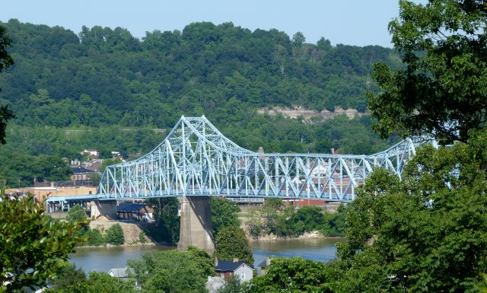
Ironton – Russell Bridge

Slide 24
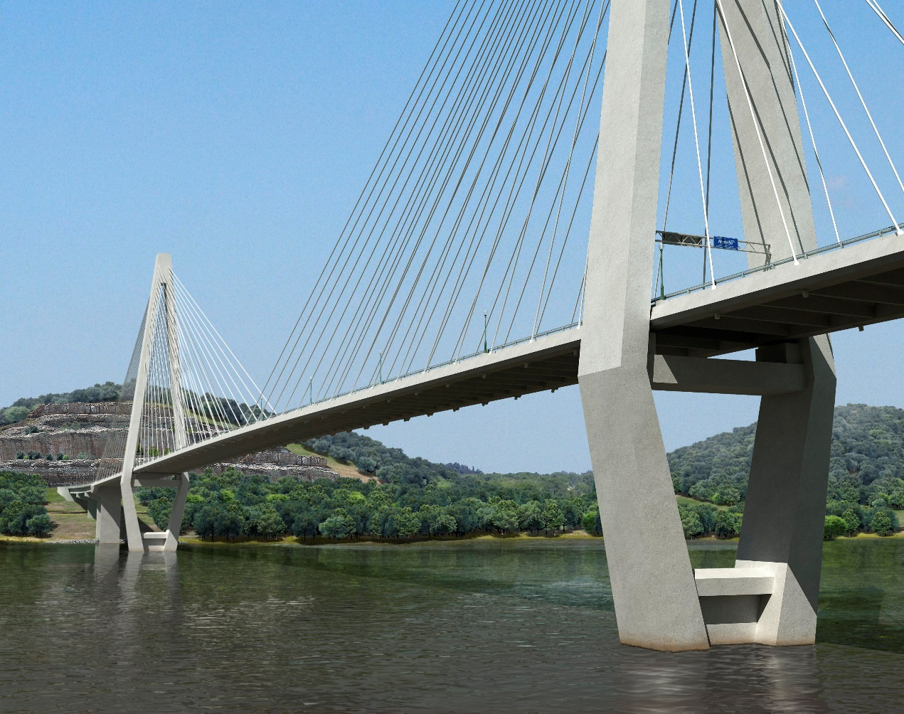
Ironton – Russell Bridge

Slide 26
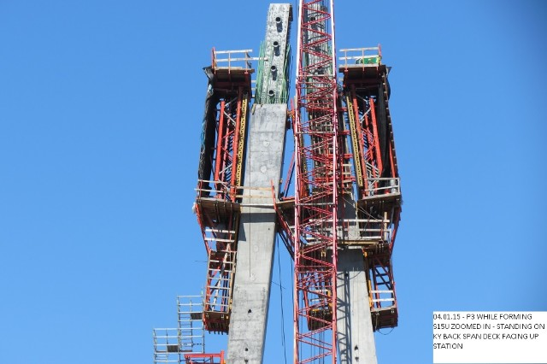
Ironton – Russell Bridge

Slide 27
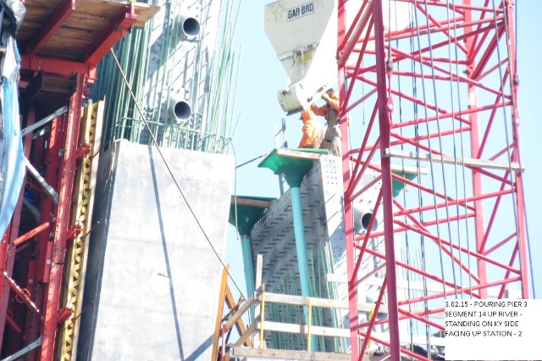
Ironton – Russell Bridge

Slide 31
Ironton – Russell Bridge
ODOT Construction and Material Specifications (C&MS) 711.02
ASTM A123: Standard Specification for Hot-Dipped Galvanized Coatings on Iron and Steel Products
ASTM A384: Standard Practices for Safeguarding against Warpage and Distortion During Hot-Dip Galvanization on Steel Assemblies

Slide 32
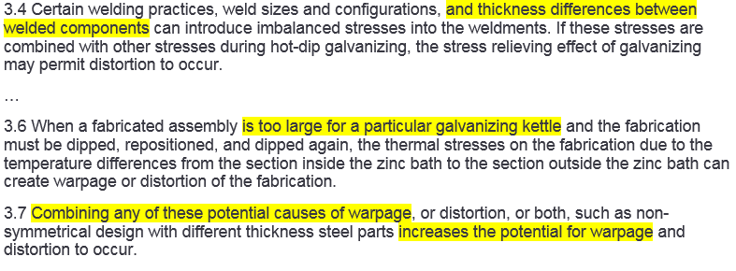
Ironton – Russell Bridge
ASTM A384

Slide 33
Ironton – Russell Bridge
Bridge Design Manual
302.4.2.1 GALVANIZED BEAM STRUCTURES If a galvanized bridge structure is the selected structure type, the following problems should be recognized and dealt with by the designer. Galvanizing tanks are shallow and normally not longer than 45 feet [13.7 meters] in length. Therefore, beam lengths should not be longer than 60 feet [18.5 meters]. Before a design is BDM SECTION 300 DETAIL DESIGN July 2007 3-27 completed, the designer should confirm with local galvanizers if a local plant can galvanize the structural members detailed.

Slide 34
Ironton – Russell Bridge
ASTM A123

Slide 35
Ironton – Russell Bridge
Pre-Galvanization Meeting

Slide 38
Ironton – Russell Bridge
ODOT
Contractor
DESIGNER

Slide 39
Ironton – Russell Bridge
ODOT
Contractor
DESIGNER
Fabricator
Galvanizer

Slide 40
Ironton – Russell Bridge
ODOT
Contractor
DESIGNER
Fabricator
Galvanizer

Slide 41
Ironton – Russell Bridge
ODOT
Contractor
DESIGNER
Fabricator
Galvanizer

Slide 42
Ironton – Russell Bridge
ODOT
Contractor
DESIGNER
Fabricator
Galvanizer

Slide 43
Ironton – Russell Bridge
ODOT
Contractor
DESIGNER
Fabricator
Galvanizer

Slide 44
Ironton – Russell Bridge
ODOT
Contractor
DESIGNER
Fabricator
Galvanizer

Slide 45
Ironton – Russell Bridge
Consultant
Consultant
ODOT
DRB
Contractor
DESIGNER
Fabricator
Galvanizer

Slide 46
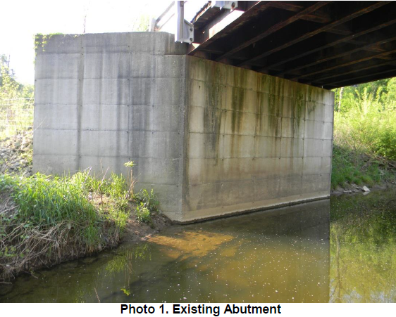

Slide 47
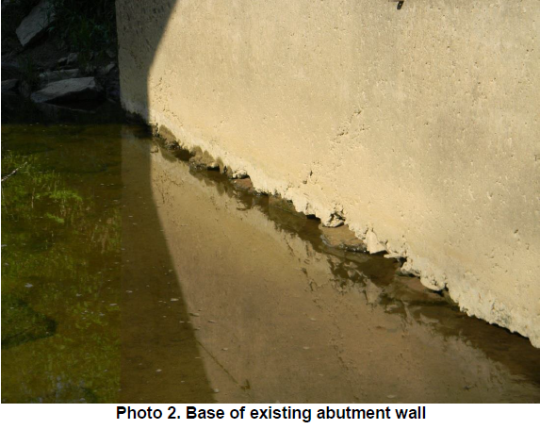

Slide 48
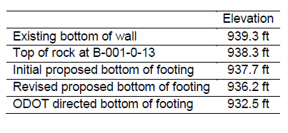

Slide 49
204.1 FOOTING ELEVATIONS Substructure footing elevations should be shown on the Final Structure Site Plan. The top of footing should be a minimum of one foot [0.3 meters] below the finished ground line. The top of footing should be at least one foot [0.3 meters] below the bottom of any adjacent drainage ditch. The bottom of footing shall not be less than four feet [1.2 meters] below and measured normal to the finished groundline. BDM SECTION 200 PRELIMINARY DESIGN April 2010 2-24.3
Where footings are founded on bedrock (note that undisturbed shale is bedrock) the minimum depth of the bottom of the footing below the stream bed, D, in feet [meters], shall be as computed by the following: D = T + 0.50Y Where: T = Thickness of footing in feet [meters] Y = distance from bottom of stream bed to surface of bedrock in feet [meters] The footing depth from the above formula shall place the footing not less than 3 inches [75 mm] into the bedrock.

Slide 50
204.1 FOOTING ELEVATIONS Substructure footing elevations should be shown on the Final Structure Site Plan. The top of footing should be a minimum of one foot [0.3 meters] below the finished ground line. The top of footing should be at least one foot [0.3 meters] below the bottom of any adjacent drainage ditch. The bottom of footing shall not be less than four feet [1.2 meters] below and measured normal to the finished groundline. BDM SECTION 200 PRELIMINARY DESIGN April 2010 2-24.3
Where footings are founded on bedrock (note that undisturbed shale is bedrock) the minimum depth of the bottom of the footing below the stream bed, D, in feet [meters], shall be as computed by the following: D = T + 0.50Y Where: T = Thickness of footing in feet [meters] Y = distance from bottom of stream bed to surface of bedrock in feet [meters] The footing depth from the above formula shall place the footing not less than 3 inches [75 mm] into the bedrock.

Slide 51
204.1 FOOTING ELEVATIONS Substructure footing elevations should be shown on the Final Structure Site Plan. The top of footing should be a minimum of one foot [0.3 meters] below the finished ground line. The top of footing should be at least one foot [0.3 meters] below the bottom of any adjacent drainage ditch. The bottom of footing shall not be less than four feet [1.2 meters] below and measured normal to the finished groundline. BDM SECTION 200 PRELIMINARY DESIGN April 2010 2-24.3
Where footings are founded on bedrock (note that undisturbed shale is bedrock) the minimum depth of the bottom of the footing below the stream bed, D, in feet [meters], shall be as computed by the following: D = T + 0.50Y Where: T = Thickness of footing in feet [meters] Y = distance from bottom of stream bed to surface of bedrock in feet [meters] The footing depth from the above formula shall place the footing not less than 3 inches [75 mm] into the bedrock.

Slide 52
BDM 204.1 Footing Elevation has Three Requirements:
Minimum Depth for Top of Footing Footing @ 933.0’
Minimum Depth for Bottom of Footing Footing @ 934.0’
No less than 3” into bedrock Footing @ 938.0’

Slide 53
DCB → Entitled to Compensation for .5’ extra footing depth

Slide 54
Questions?
Nathan.Fling@dot.ohio.gov
(614) 466-2140

